Slide 1
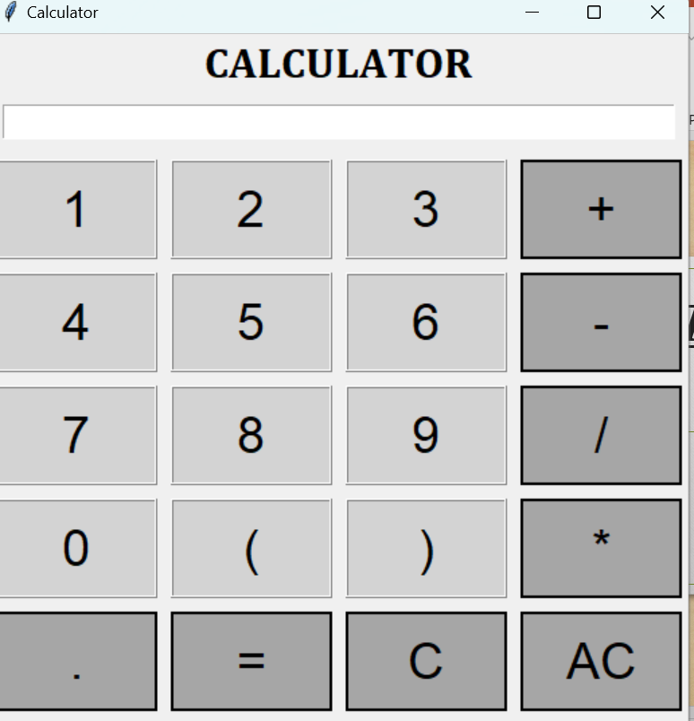
The Calculator
Python GUI Calculator

Slide 2
Tkinter Library
This is the Python based GUI (Graphical user interface) library.
This is oner of the easiest and the fastest library to work with .
It’s easy to add on widgets that can make the script look more interactive.
Addition of buttons , command lines , Check buttons etc.

Slide 3
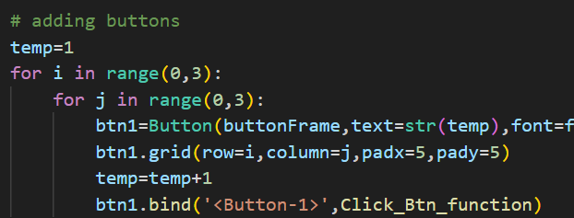
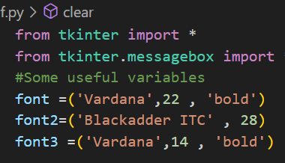
CODE STRUCTURE :-
Different fonts are being used in the calculator to differentiate the sections.
To create buttons we have used loop to define first 9 digits.

Slide 4
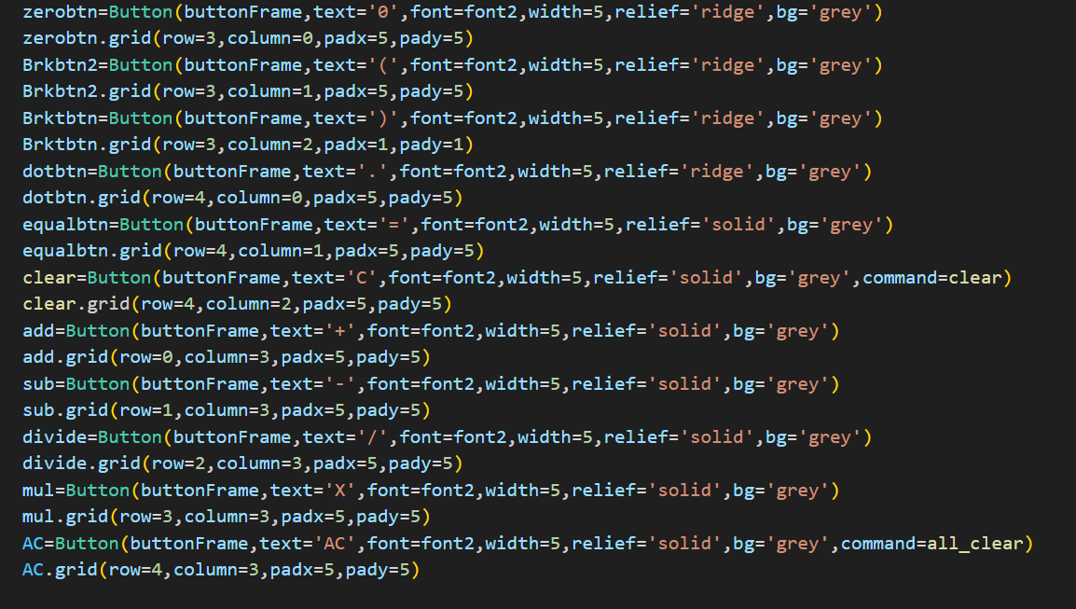
Other Buttons are being hard coded for the perspective use :

Slide 5
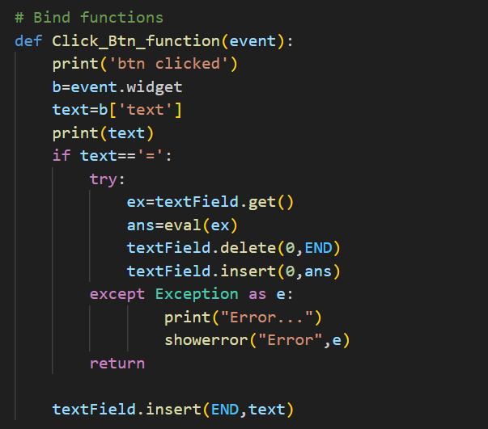
Error Handling :
Errors can be made by giving wrong syntax or dividing the expression by 0 . Therefore for these cases error handling is done to stop executing with wrong outputs.

Slide 6
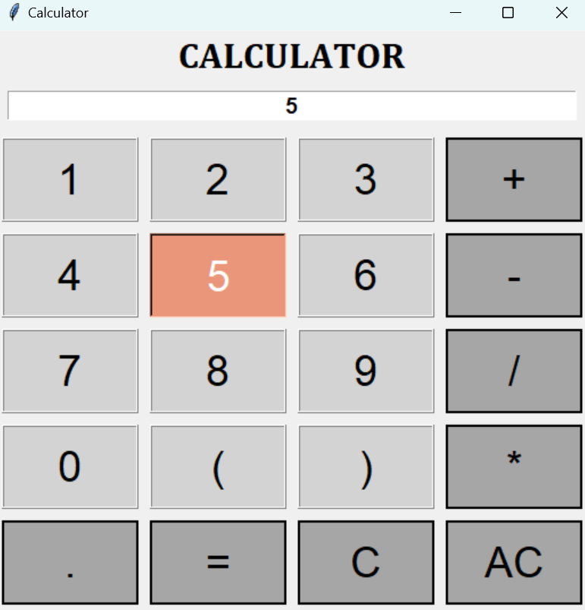
Color Coding for the Calculator
All the numeric are given with the snow color and operators are built with different color. Different coding is being done.

Slide 7

Conclusion
Tkinter is a very effective library to create innovative and interactive GUI products. All the inbuilt functions of the library is very simple to use and easily understandable to use.

